Slide 1
Brain age as a biomarker of cognitive decline
Doering, E., Antonopoulοs, G., Hönig, M., van Eimeren, T., Eickhoff, S., Patil, K.*, Drzezga, A.* for the Alzheimer’s Disease Neuroimaging Initiative * authors contributed equally
Notes:
Welcome to everyone and thank you for giving me the opportunity to show you our work on brain age and its clinical utility as a biomarker of cognitive decline

Slide 2
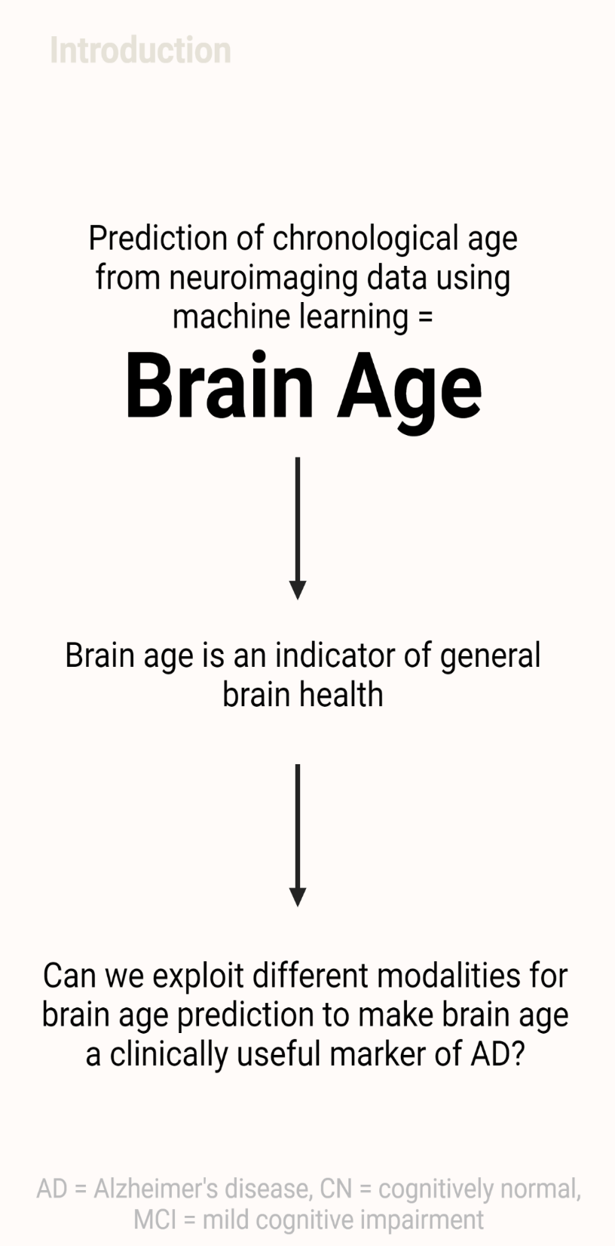


age = 75
CA = 63 BA = 75
Chronological Age = 63
Brain age Prediction
Brain-Predicted Age Difference
= 12 years
Alzheimer’s: 5-9 years Beheshti et al., 2020, Rokicki et al., 2021
Parkinson’s: 3 years Eickhoff et al., 2021
Schizophrenia: 3-6 years Rokicki et al., 2021
HIV: 2 years Cole et al., 2017
Diabetes: 2 years Cole et al., 2020
How can we use brain age for AD?
Notes:
So what is brain age?
When we speak about brain age, we refer to the concept of machine learning algorithms learning to predict chronological age from neuroimaging data. Typically, brain age is predicted from MRI scans.
Here is a short illustration. We have an exemplary brain of a person who is 63 years old. Our trained machine learning algorithm predicts that this person’s brain looks like it is 75 years old. Therefore, our algorithm predicts that this person’s brain looks 12 years older. This difference between brain-predicted age and chronological age is called brain-predicted age difference, or short BPAD.
BPAD summarizes general brain health and has been shown to be advanced in a variety of neurological conditions, such as Alzheimer’s disease, as well as non-neurological conditions.
Which mechanisms of Alzheimer’s disease are associated with advanced BPAD and how BPAD can be used in clinical practice is what I will speak about today.

Slide 3
Research aims
Precision of brain age MRI vs FDG-PET in cognitively normal individuals (CN).
Association of brain-predicted age difference (BPAD) in MRI and FDG-PET with
AD Neuropathology
Cognitive decline
… in CN and individuals with mild cognitive impairment (MCI)
Notes:
Since both MRI, but also FDG-PET can be used to depict early neurodegeneration-associated changes across the Alzheimer’s disease spectrum, our first goal was to test, whether FDG-PET, too, can be used to assess brain age.
Next, the difference between brain age and chronological age, which, again, is called BPAD, on MRI and FDG-PET was associated with
*CLICK* neuropathology
*CLICK* and cognitive decline
*CLICK* both in cognitively normal individuals, as well as in individuals with mild cognitive impairment.

Slide 4



Participants
Table 1. Overview of samples
 | CN | CN_validation | MCI
n total | 367 | 59 | 513
Age [avg. years (SD)] | 74.2 (5.68) | 71.7 (4.15) (PET)/ 70.4 (4.17) (MRI) | 74.9 (5.77)
Sex (%F) | 51 | 59 | 40
MMSE [avg. score] | 29 (1.24) | 29 (.85) | 28 (1.77)
Education [avg. years] | 16 (2.72) | 16 (2.70) | 16 (2.70)
Notes:
Our algorithms were trained on data from 367 cognitively normal individuals from the ADNI. To be included, all participants had to be at least 65 years of age, and they had to have an FDG-PET scan and an MRI scan within the time frame of one year. For validation of our results for the first task, we used a sample of 59 individuals from the OASIS database and for the analyses including MCI participants, 513 FDG-PET and MRI scans were downloaded from the ADNI.

Slide 5
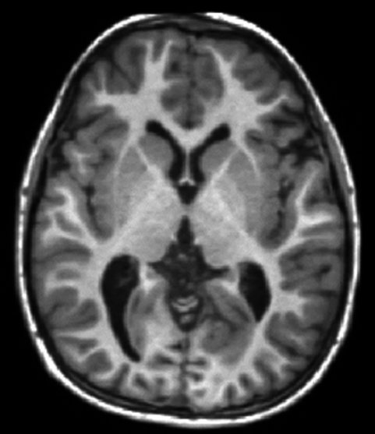

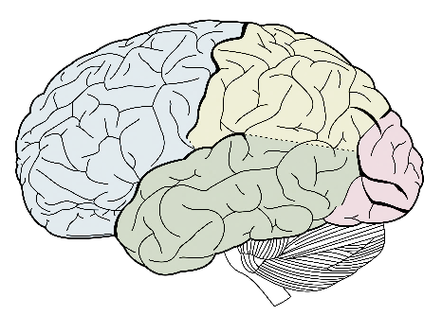
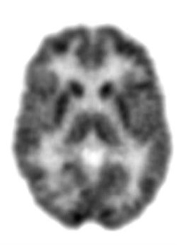
Pre-Processing
Mean gray matter volume (CAT)
MRI
216
2
Standardized uptake value ratio (SPM12)
FDG-PET
216 cortical and subcortical brain regions
2 models (SVR & RVR) with 3 tunable parameters (kernel, degree, C) each
Notes:
Gray matter volume and SUVR were extracted for MRI and FDG-PET, respectively. Voxel information was summarized into 216 brain regions and this vectorized data was fed into two different kinds of algorithm for comparison.

Slide 6
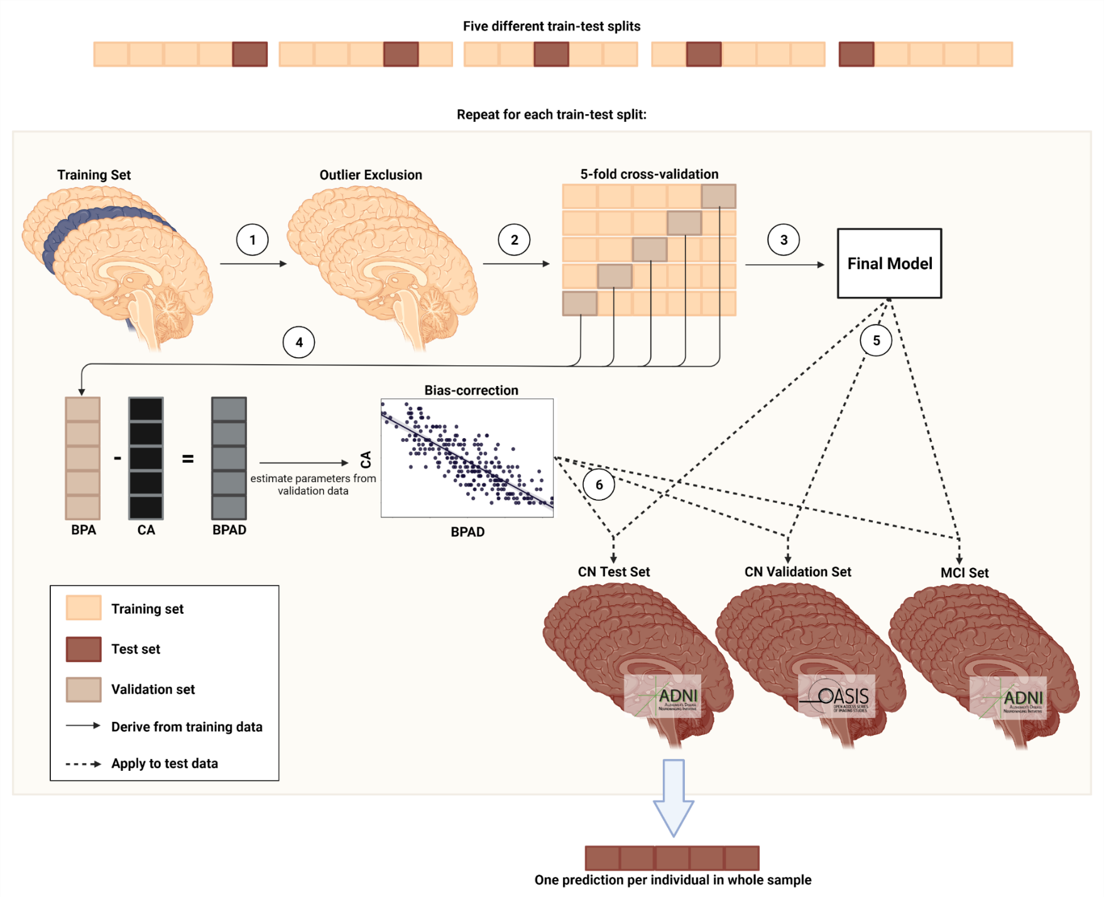
Figure 1. Pipeline for brain age prediction using nested cross-validation. (1) Outliers are excluded from the training set. (2) Training data is divided into five training/validation folds. (3) Cross-validation yields the final model for brain age prediction. (4) BPAD is used for bias correction. (5) Final model is used to yield predictions for test sets. (6) Bias-correction parameters are applied to test sets. BPA = brain-predicted age; CA = chronological age, BPAD = brain-predicted age difference.
Notes:
To train the models, we split the ADNI CN sample into five different train-test folds *point to upper train test split*. Each train set was then used to train the machine learning models and these trained models were then applied to all test sets.

Slide 7
Precision in brain age prediction is comparable across FDG and MRI
Table 2. Precision of predicting chronological age from FDG-PET and MRI scans. For CN_validation and MCI, results of the first model and metrics over all five models are shown.
 | CN |  | CN_validation |  | MCI
 | FDG | MRI | FDG | MRI | FDG | MRI
n total | 345⁺ | 345⁺ | 59⁺ | 59⁺ | 621 | 621
MAE | 1.99 | 1.89 | 1.83 | 2.42 | 1.96 | 2.68
Mean difference | -0.10 | -0.05 | -0.80 | -0.80 | 0.78 | 1.75
Notes. *After outlier exclusion using CN train set (IQR > 6)
Notes:
Precision in brain age prediction was comparable across FDG-PET and MRI with a mean absolute error of about 2 years in both modalities in the ADNI and OASIS test set, which is vvery good in comparson to existing brain age approaches. In this main sample, individuals’ brains looked about as old as would be expected for their chronological age.
In the OASIS dataset containing cognitively normal individuals, the prediction of chronological age from neuroimaging data worked slightly better using FDG-PET data.
For the MCI sample, prediction is not expected to be accurate, but rather, we would expect to see a positive deviation of brain age from chronological age. And that was the case here, especially when brain age was assessed with MRI.

Slide 8
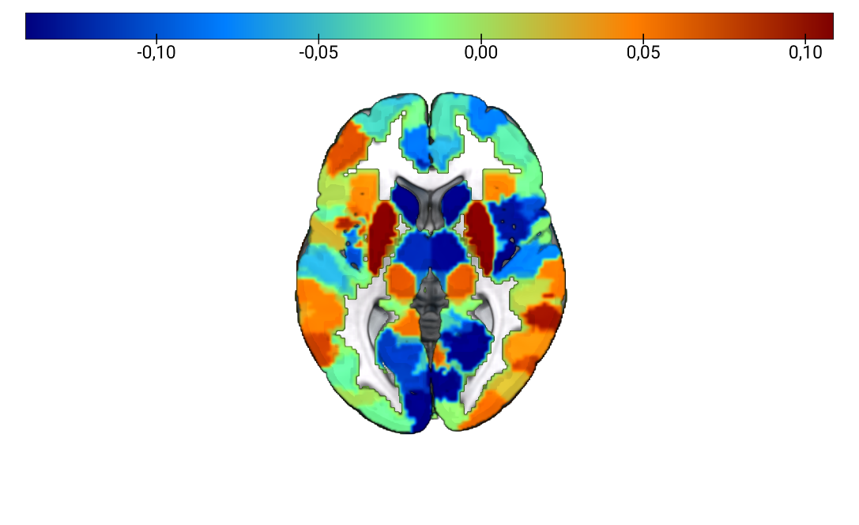
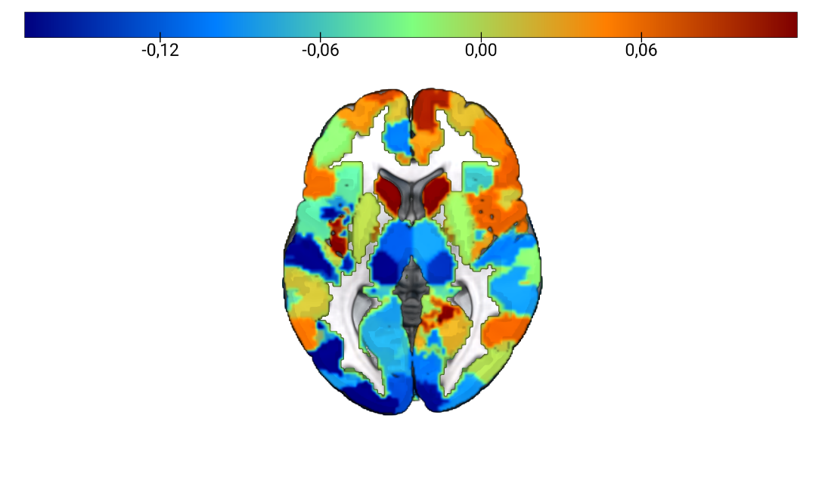
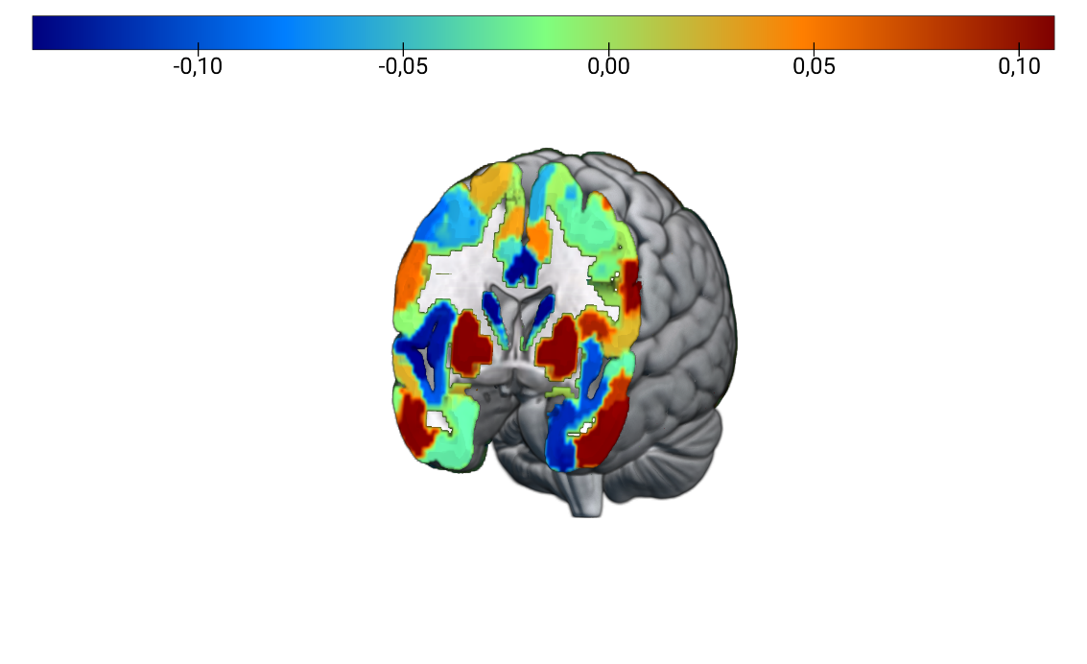
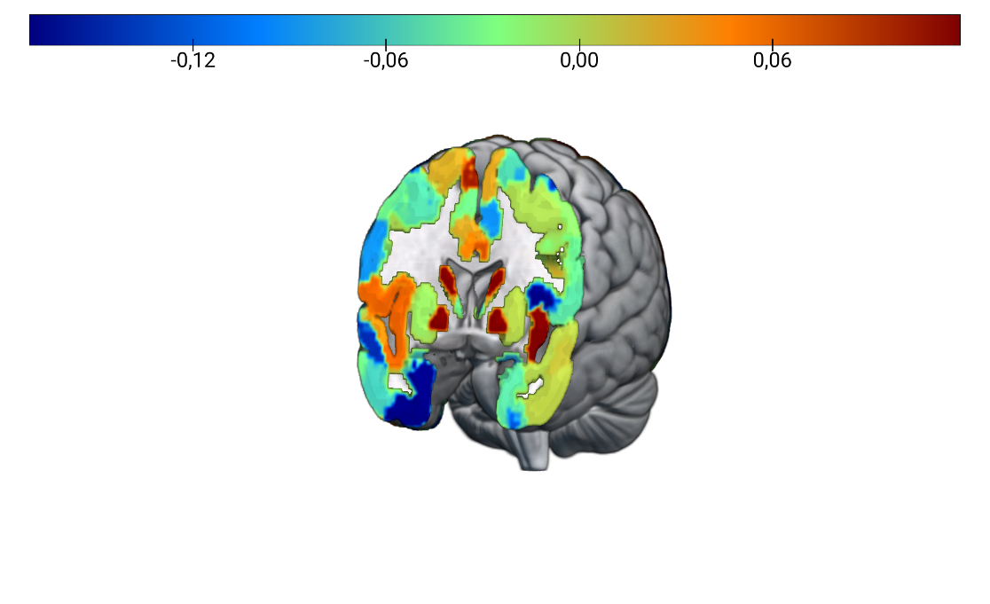
Brain Regions for Prediction of Brain Age are Different between FDG-PET and MRI
FDG-PET
MRI
(A)
(B)
Figure 2. Feature importance for brain age prediction. (A) Average weights of support vector regression across three models for brain age prediction using FDG-PET. Two out of the five train test splits required a non-linear kernel for optimal prediction of brain age. Weights were highly correlated across models (r > 0.8). (B) Average weights of support vector regression across all five models for brain age prediction using MRI. Weights were highly correlated across models (r > 0.8).
Notes:
Brain regions relevant for the assessment of brain age were quite different between FDG-PET and MRI. Very important regions here are the ones in dark red or blue. In both modalities, however, we see regions typically associated with aging, as well as typically associated with Alzheimer’s disease, thus supporting claims that Alzheimer’s disease-associated neurodegeneration depicts an advanced biological aging process at least for the brain.

Slide 9

BPAD and AD Neuropatholgy
“good”
“bad”
0
BPAD
Notes:
Now I present results from partial correlations between BPAD and cross-sectional AD neuropathology, corrected for age and sex.

Slide 10
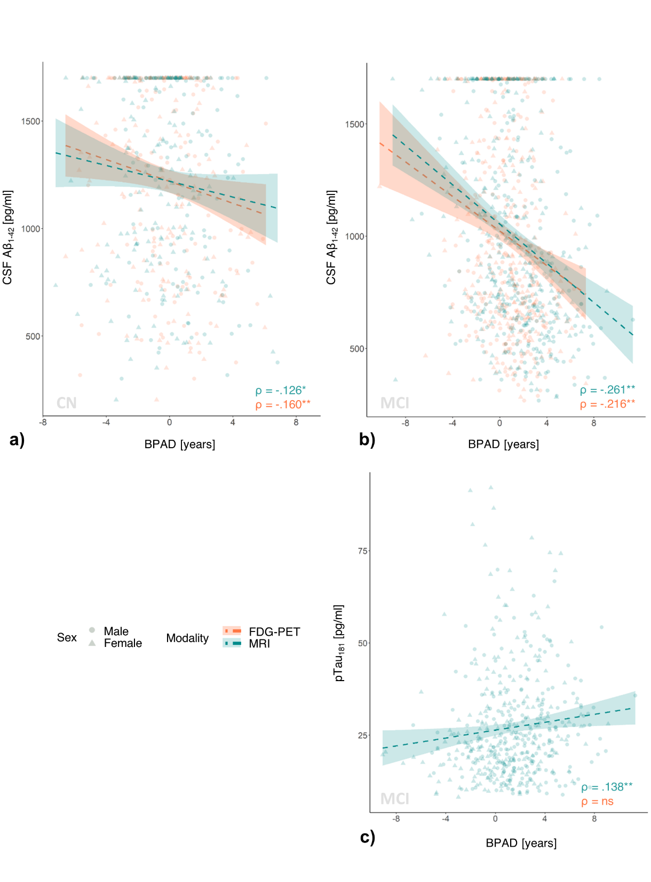
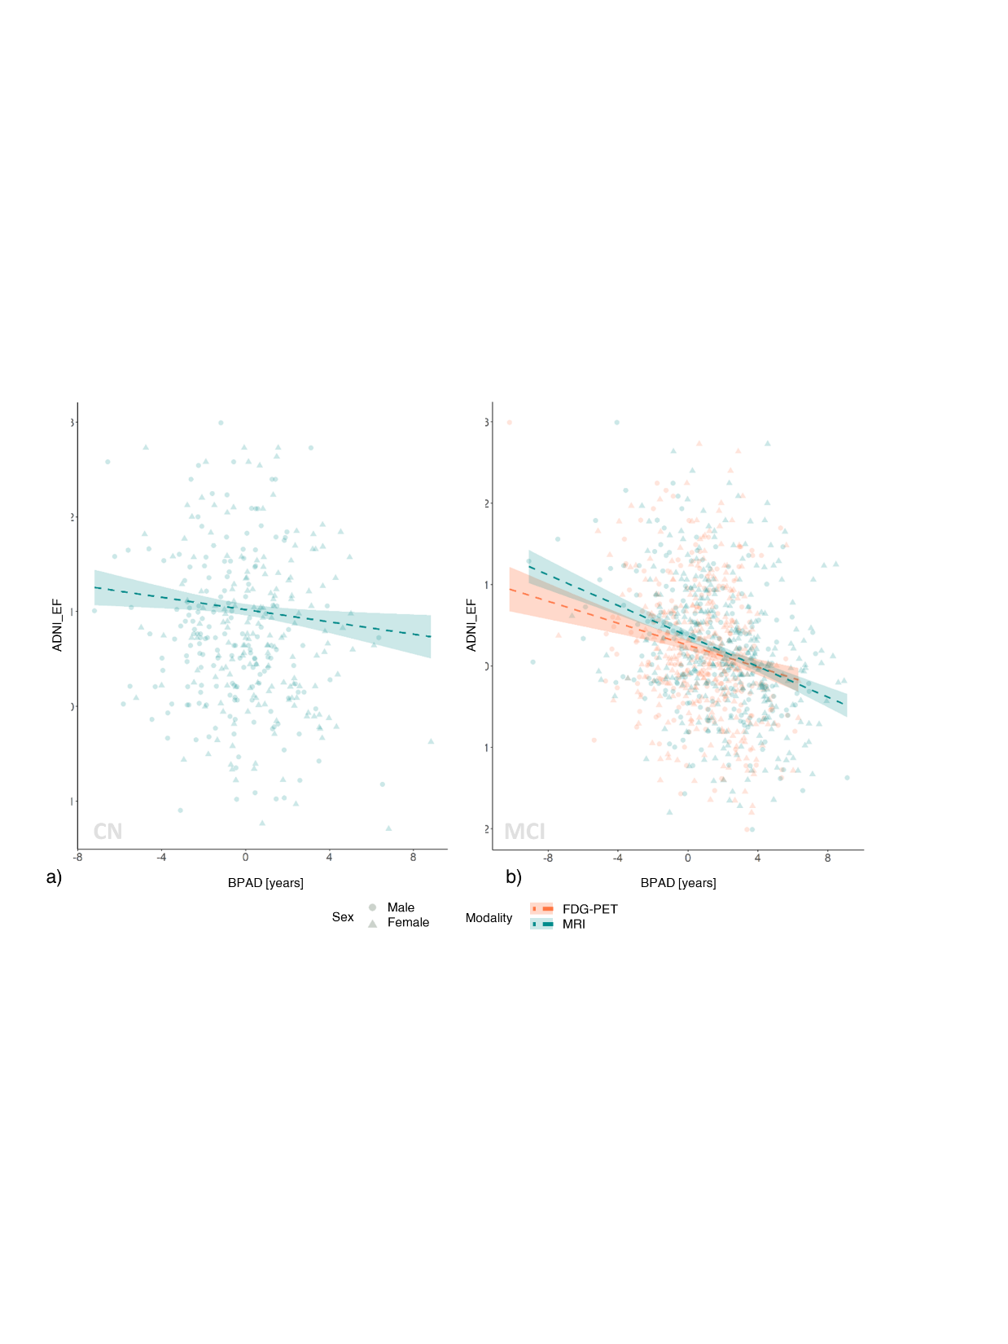
AD Neuropathology increases with increasing BPAD
CSF Aβ₁₋₄₂
CSF pTau₁₈₁
CN
MCI
MCI
* p < 0.05 ** p < 0.05 (corrected)
Notes:
On the left, we see that especially FDG-BPAD was significantly associated with amyloid burden in CN.
In MCI, both MRI and FDG-BPAD were associated with CSF amyloid.
Correlations of BPAD and tau were only present in MCI patients. Here, we found a weak, positive correlation between CSF tau and ptau and MRI-BPAD.

Slide 11
BPAD and Cognitive Decline
Cognitive decline = a diagnosis of (more severe) cognitive impairment within 2 years
Samples of converters and non-converters matched for age & sex
Logistic regression using
FDG-BPAD, MRI-BPAD, amyloid status, APOE-e4 carriership, years of education
Notes:
Now I present results from logistic regression analyses for the prediction of cognitive decline on samples matched for age and sex.
Cognitive decline was defined as a diagnosis of more severe impairment within 2 years. Assessed predictors for cognitive decline were FDG-BPAD, MRI-BPAD, amyloid status, APOE-e4 carriership and years of education.

Slide 12
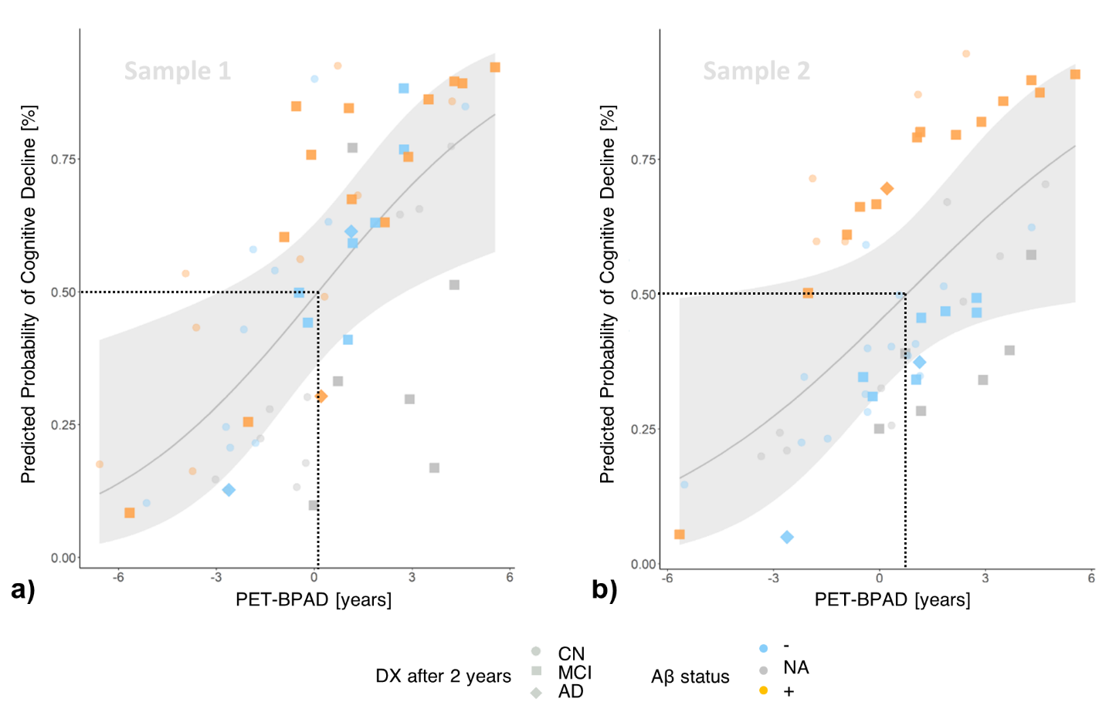
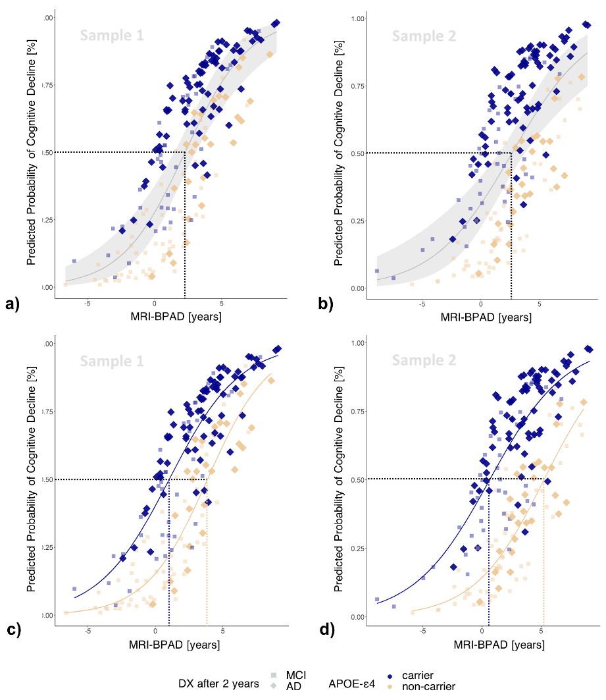
BPAD predicts cognitive decline
Lower threshold in presence of pathology
Higher threshold
for APOE-e4 non-carriers
Notes:
In cognitively normal individuals, amyloid status and FDG-BPAD predicted cognitive decline within two years.
Precisely, an FDG-BPAD of 0.6 years was derived as a threshold for heightened probability of cognitive decline,
Possibly, this threshold is dependent on the presence of amyloid pathology in the brain, as it seems that cognitively normal individuals with a positive amyloid status are at advanced risk of cognitive decline already at lower BPAD.
In MCI patients, APOE-e4 carriership and MRI-BPAD predicted development of AD within two years.
Precisely, an MRI-BPAD of 2.3 years was derived as a threshold for heightened probability of cognitive decline,
Again, this threshold likely is modified by other factors, such as APOE-e4 carriership.

Slide 13

FDG-BPAD better captures early disease-related neuropathology and risk. Onset of tau-related neurodegeneration is more strongly with signals of increasing BPAD on MRI.
Notes:
Zusammenfassend haben wir gezeigt, dass sowohl FDG-PET, als auch MRT genutzt werden können um Hirnalter zu berechnen. Beide haben ihre eigenen, scheinbar relative exklusiven Vorteile für bestimmte Stadien im Alzheimer Kontinuum. FDG BPAD hat Alzheimer Pathologie und kognitive Verschlechterung bei gesunden besser vorhergesagt, während MRT BPAD für die MCI Population besser geeignet war. *CLICK* Während FDG-PET Hirnalter also mehr Sensitivität für sehr frühe Veränderungen und Prognosen zeigt, ist bei bereits bestehenden kognitiven Einschränkungen MRT für die Berechnung des Hirnalters eher zu empfehlen.

Slide 14

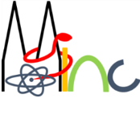


















Thank you for your attention!
Dr. Gérard Bischof
(PostDoc)
Dr. Kathrin Giehl
(Study coordinator)
Dr. Merle Hönig
(PostDoc)
MultiModal
Prof. Dr. Thilo van Eimeren
Head of MMNI Group,
Dpt. of Neurology & Nuclear Medicine
Dr. Hendrik Theis
(MD)
NeuroImaging
Elena Doering
(PhD student)
Prof. Dr. Simon Eickhoff
Director of the Institute Brain and Behaviour (INM-7)
Dr. Kaustubh Patil
Leader of the research group “Applied Machine Learning”
Group.de
Verena Dzialas
(PhD student)
Julia Pfeil
(PhD student)
Prof. Dr. Alexander Drzezga
Head of Dpt. Nuclear Medicine
& INM-II, Research Center Jülich
Magdalena Banwinkler
(PhD student)
Dr. Georgios Antonopoulos
(PostDoc)
Adrian Asendorf
(PhD student)
Contact info: elena.doering@uk-koeln.de

Slide 15
References
Beheshti I. et al. T1-weighted MRI-driven brain age estimation in Alzheimer’s disease and Parkinson's disease. Aging Dis. 11(3):618–628, (2020).
Cole, J. H. et al. Increased brain-predicted aging in treated HIV disease. Neurology 88, (2017).
Cole, J. H. Multimodality neuroimaging brain-age in UK biobank: relationship to biomedical, lifestyle, and cognitive factors. Neurobiol. Aging 92, (2020).
Eickhoff, C. R. et al. Advanced brain ageing in Parkinson’s disease is related to disease duration and individual impairment. Brain Commun. 3, (2021).
Rokicki, J. et al. Multimodal imaging improves brain age prediction and reveals distinct abnormalities in patients with psychiatric and neurological disorders. Hum. Brain Mapp. 42, (2021).

Slide 16
BPAD and Cognitive Performance
“good”
“bad”
0
BPAD
Notes:
Now I present results from partial correlations between BPAD and cross-sectional cognitive performance, corrected for age and sex.
In the following graphs, BPAD is on the x-axis and the higher BPAD, the older the brain looks compared to an individuals chronological age.

Slide 17
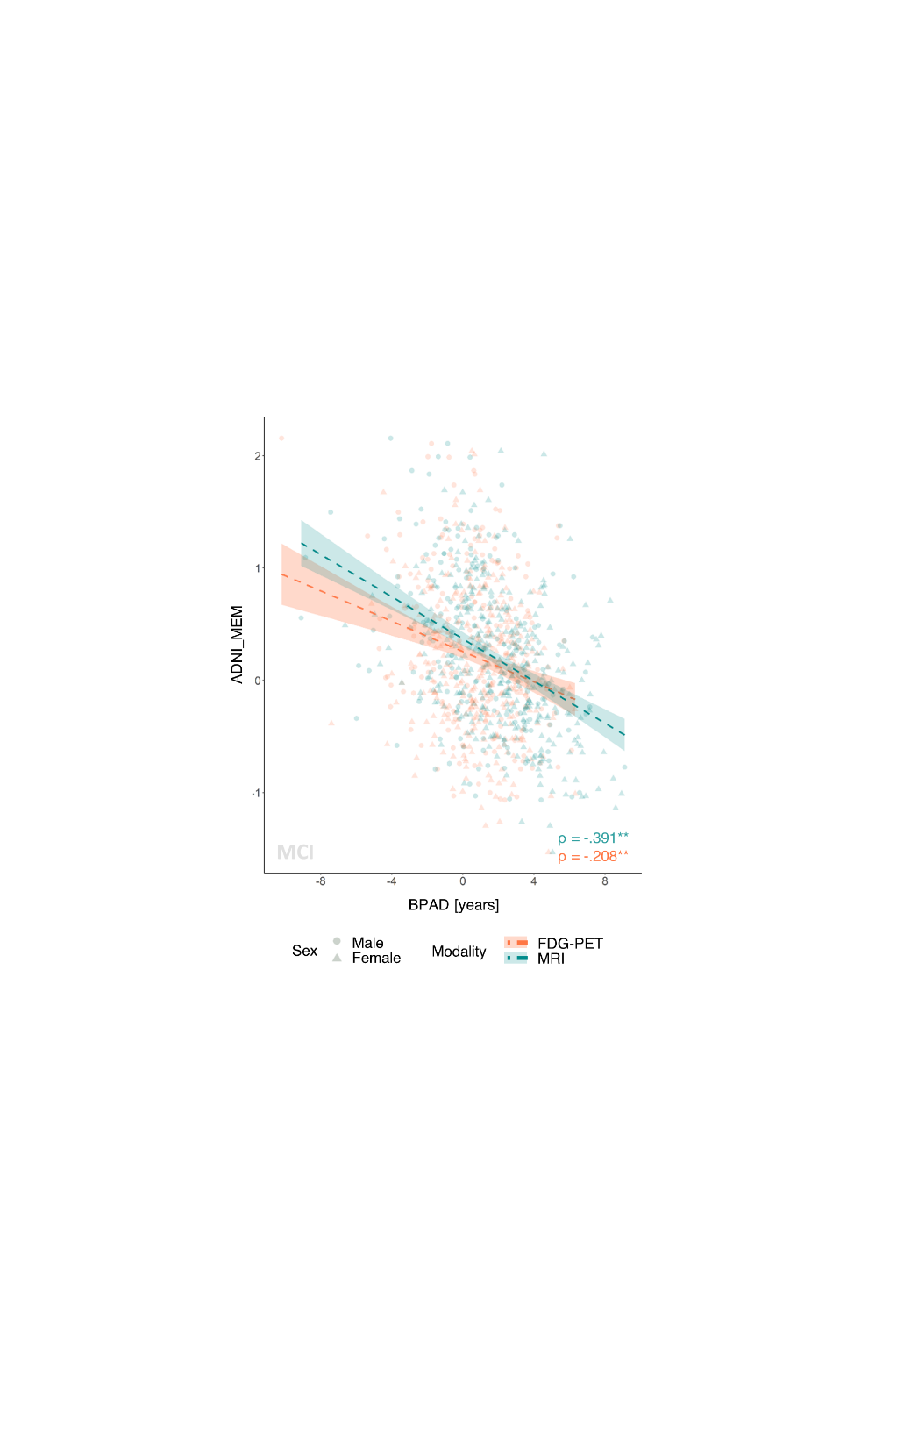
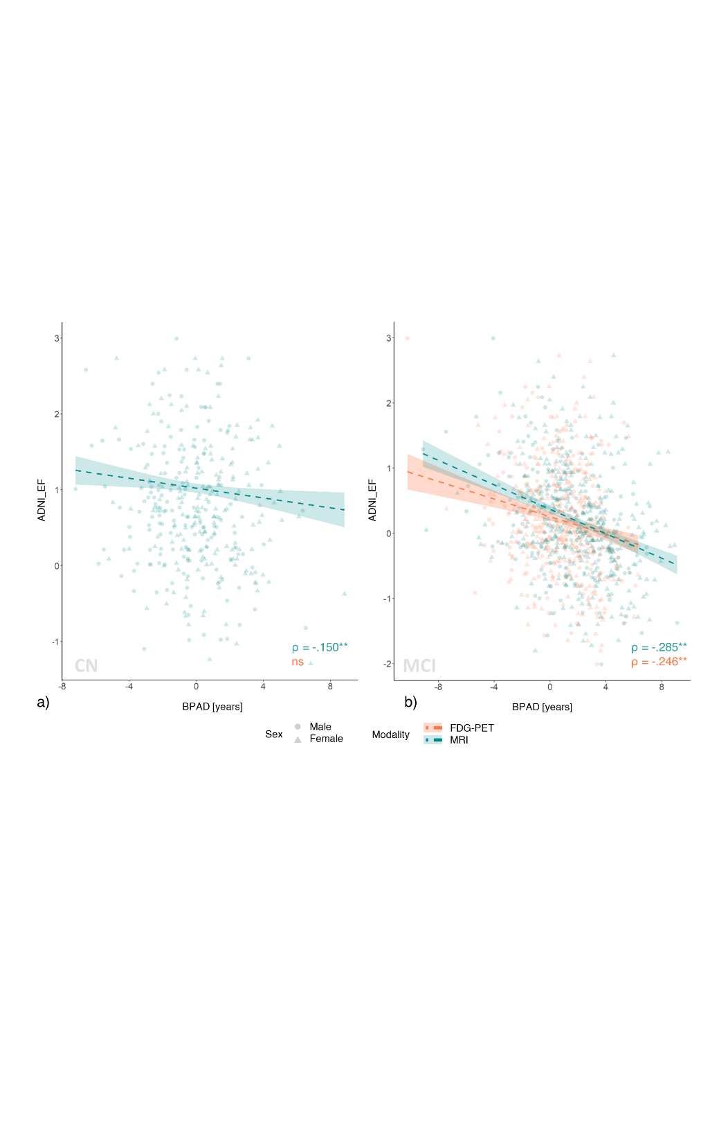
Cognitive performance declines with increasing BPAD
Memory
Executive Function
MCI
CN
MCI
* p < 0.05 ** p < 0.05 (corrected)
Notes:
Memory was not associated with BPAD in CN, while in MCI, higher BPAD was correlated with a worse memory performance.
On the right hand side, we see that higher BPAD, especially on MRI, was associated with a decline of executive function.

Slide 18
Nothing to disclose.
Notes:
First of all, I would like to thank the organizers of ADPD 2022 for giving me the opportunity to speak to you today and mention that I have nothing to disclose.

